Slide 1
States : Queen’s position/arrangement
Goal test : All queens are placed on the board, No queen is within the move/attack range of another queen
Actions : Move Queen within row (has to move to a location that has the least amount of other queens move/attack range)
Initial state : Randomized queen position
Path cost : 0

Slide 2
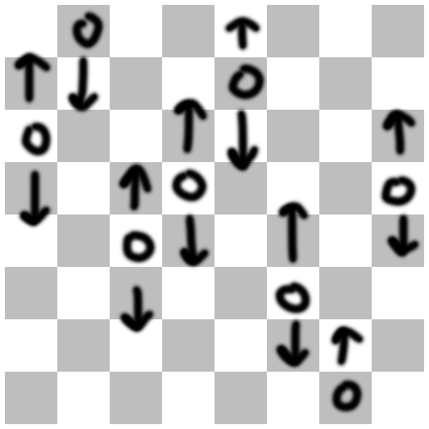

Slide 3
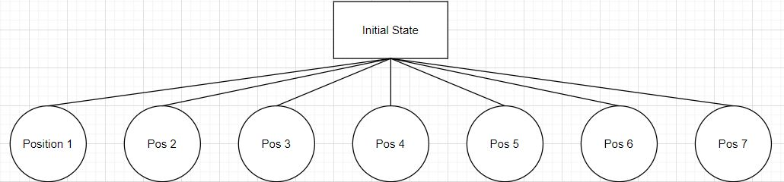
1st move
Queen 1

Slide 4
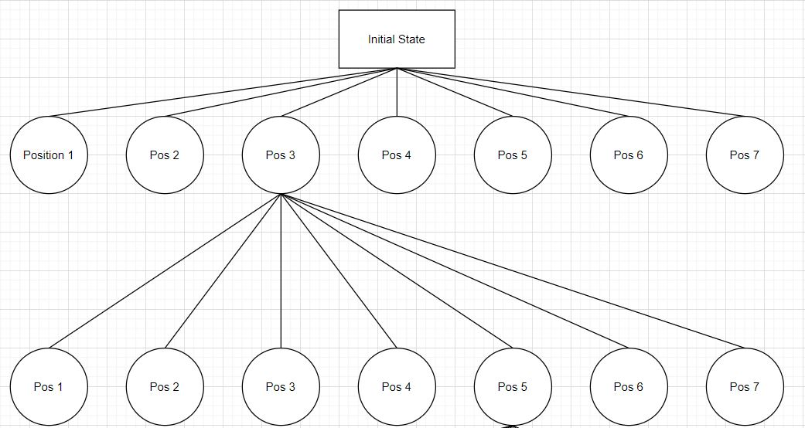
2nd move
Queen 1
Queen 2

Slide 5
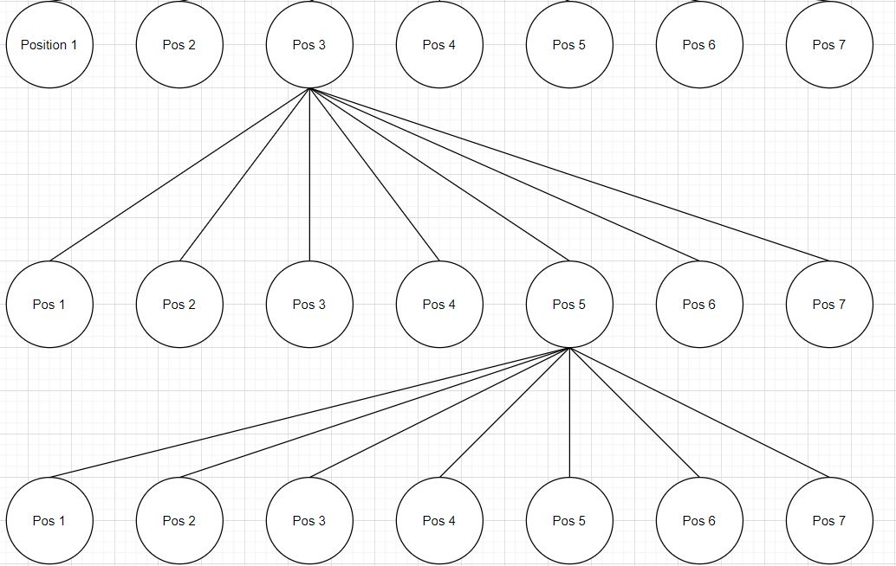
3rd move
Queen 1
Queen 2
Queen 3

Slide 6
So on and so forth, until goal is reached

